Slide 1
Page Layout
Header & Footer
Font Styles
Image wrapping
List Styles
Indentation & Spacing
Find & Replace
Create/Format Table
Common Mistakes
Orphan & Widows
Completed Example
Mail Merge

Slide 2
Page Layout (Size & Orientation)
Top Margin
Left Margin
Right Margin
Click on the Page Layout tab to make changes to the page (Size, Orientation and margins).
Bottom Margin

Slide 3
Page Layout (Margins)
Margins
Click on Page layout
Click on Margins
Click on Custom Margins
Enter the margins in CM.
The top, bottom, left and right may have different margins.

Slide 4
Page Layout (Columns)
TIP:
Always double check where the columns are meant to start from.
Columns after this point
Select the amount of columns.
Set the spacing. You may need to write 1cm.
Columns
Highlight the text
Click on Page layout
Click on More Columns
Select the settings for your columns

Slide 5
Header & Footer
When inserting a header or footer make sure you select the Blank (Three Columns) option.
Left aligned
Centre aligned
Right aligned

Slide 6
Header & Footer
To insert a Page Number click on Design >> Page Number >> Current Position
To insert a File name click on Design >> Quick Parts >> Field
Click on here the add the path to the file name.

Slide 7
Font Styles
Font styles can be placed in two categories (San-Serif and Serif). San-Serif fonts have straight edges whereas Serif fonts have little ticks at the edges of each letter.
San-Serif: Arial
Serif: Times New Roman

Slide 8
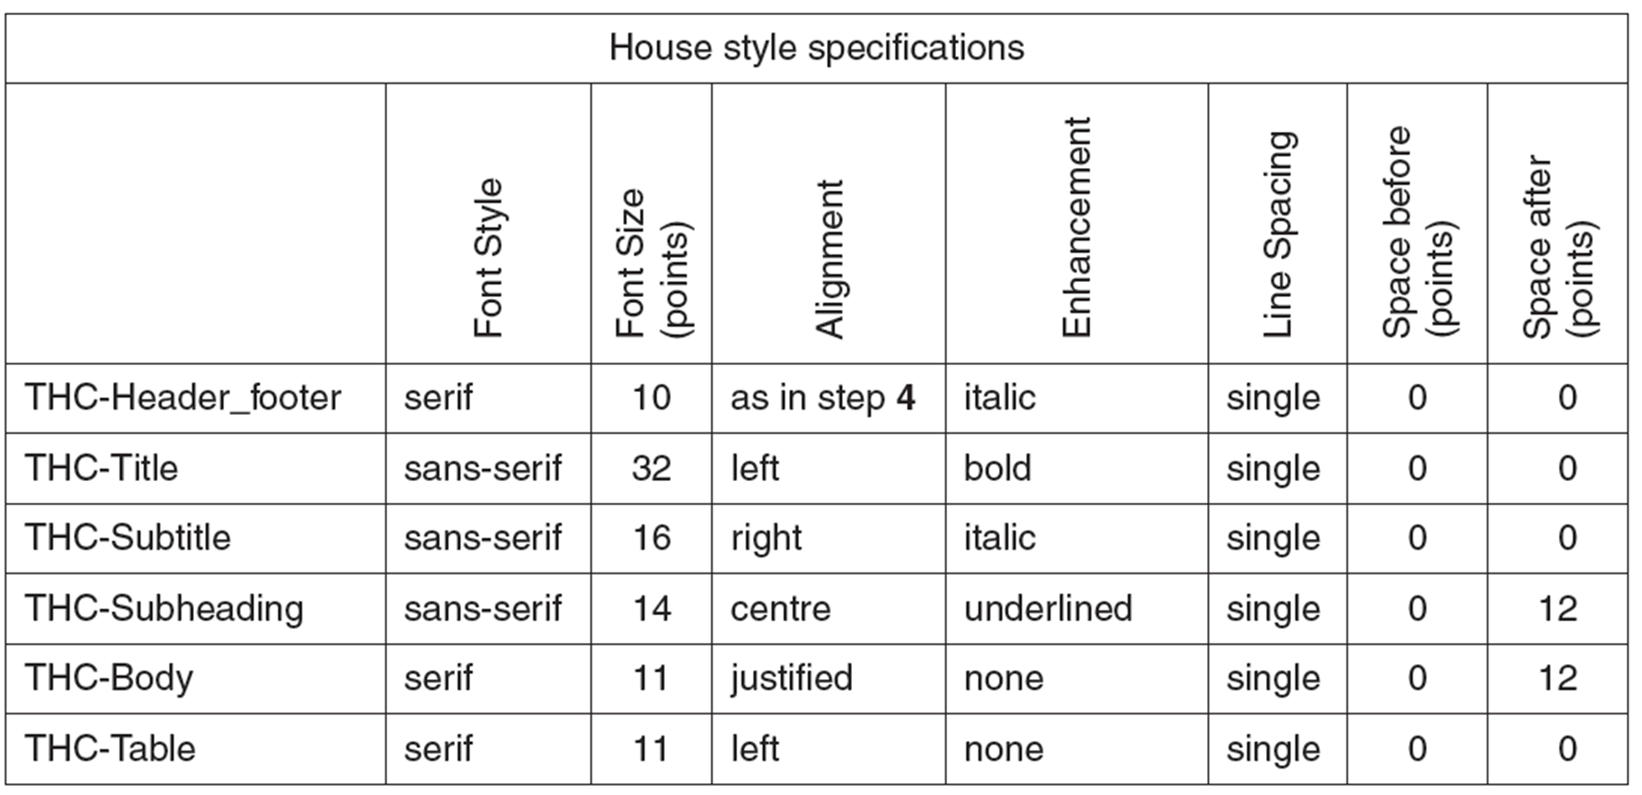
Font Styles (Exam House Style Example)
Exam Question
The alignment for the first style will be different as specific alignment will be asked for in Question 4. So you can just set is as left align as a default value.

Slide 9
Font Styles (Creating a House Style)
To create text styles click on Home >> Tab under Change Styles
Click new Style

Slide 10
Font Styles (Modifying Style)
Style Name
Text Formatting
Existing Styles can also be modified e.g. Title
Alignment
Line Spacing

Slide 11
Alignment
Line spacing changes the space between lines or paragraphs.
Left Alignment
Centre Alignment
Right Alignment
Justified

Slide 12
Line Spacing
Line spacing changes the space between lines or paragraphs.
Single Line Spacing
1.5
Line Spacing
Spacing between the lines increases
Double Line Spacing

Slide 13
Spacing (Before & After)
To add spacing click on Format >> Paragraph
Edit After to add spacing after a text style.
Tip: Refer to current font size or style sheet (house style)

Slide 14
Formatting Options
Additional formatting can also be applied to text by highlighting the text and click on the relevant icon.
Justify
Select Line Spacing
Left, Centre & Right
Image Wrapping
Wrapping Text around an image
Select the image and then click on Format
Wrap Text
Select Tight

Slide 15
List Styles
To apply a list style you need to highlight the text ad then select the relevant style icon. You can click on the arrow for further options.
Bulleted List
Numbered List

Slide 16
Remove Spacing
Highlight Text
Click on Line Spacing Icon.
Click on Remove Space After Paragraph.
Before with Space
Space Removed

Slide 17
Indentation

Slide 18
Find & Replace Tool
Find Tool: Find Specific text in your document. This tool is useful in exams as sometimes you are asked to insert items (tables, images etc.) at certain points.
Find and Replace: Will find specific text and will replace it with the text you require in the entire document.
Find
Replace

Slide 19
Create a Table
Inserting Table
Click on Table >> insert table
Select the number of rows and columns
Merging Rows
Highlight the row >> right click mouse >> select merge cells
Applying Borders
Highlight the table and apply the appropriate border settings. You can also change the weight of the border.
Applying Shading
Highlight the row that needs to be shaded. Select the colour making sure you have selected the correct percentage.

Slide 20
Formatting Table
1. Top row merged (Highlight row >> Right Click >> Merge Cells)
2. Text has been centre aligned.
3. Top row selected and grey shading selected from the fill bucket.
4. Text has been highlighted and formatted.

Slide 21
Formatting Table (Insert and Deleting Rows)
Highlight the row you would like to delete.
Right Click >> Delete>> Delete Rows
2
1
3
2
1
New row created
3
Highlight the row you would like to insert the row from (Above/Below)
Right Click >> Insert >> Insert Above
Row deleted

Slide 22
Formatting Table (Inserting & Merging Columns)
Click on the first column
Right Click >> Insert >> Insert Columns to the left (or right)
Highlight the newly created column
Right Click >> Merge Cells
1
3
2
Merged Cells
4

Slide 23
Formatting Table (Outside Border)
External Border (outside)
Highlight the table and click on the border icon.
Remove the border (including internal border).
Then select the outside border option.
1
2
Outside Border
3

Slide 24
Formatting Table (Editing Border Widths)
Border Painter
Design >> Border Painter
Border Painter can be used to customize the border (internal and external) on a table. The weight of the border can also be specifically set.
Borders have been applied

Slide 25
Formatting Table (Text Direction & Alignment)
Layout >> Text Direction
The text direction can be set using the Text Direction Icon. Text alignment can also be set.

Slide 26
Common Mistakes (Table)
Top row not formatted
Row not deleted
Inside border is displayed
Table style not applied
Corrections have been made.
Numbers not right aligned
Text is wrapped

Slide 27
Common Mistakes
Table split over two columns
Table now appears in one column

Slide 28
Common Mistakes
List split over two columns
Complete list now appears in one column

Slide 29
Common Mistakes
Inconsistent spacing between Items
Inconsistent text styles applied
Inconsistent spacing between Items

Slide 30
Orphan
If a word or subtitle (Orphan) is left then you must insert a break at the start of the column.
In this case it will be Column break so the subtitle can be added to the second column. The break will be added just before the Widow.
You can also press enter to move the title to the next column.

Slide 31
Widow
If the end of a paragraph is left (line and a half) on a new page then you need to insert a page break.
The page break will be inserted at the beginning of the paragraph.
This will mean the new paragraph will start on the new page.

Slide 32
Completed Example
Imported Extract from Access
Title and Sub Title
Header
Subheading
Correct styles applied
Spacing between all items is consistent
Indented Bullets
Two columns applied after first paragraph
Tables/images correctly formatted and placed with margins
Table
Tables/Lists do not overlap over two columns
There are no widows or orphans
Footer
Inserted Image

Slide 33
A mail merge document is designed to be sent to many people. The Mail Merge consists of two components:
Master Document
Source file containing the data (Spreadsheet or Database)
Data from the source file (names and addresses) is combined with the Master document so that key fields do not need to be typed one by one.
This will save time and reduce the chance of errors in the document.
Master Document
Merged
Source Data

Slide 34
For a mail merge you need a master Word Document
Data Source : Which will contain the recipient data
Excel (Workbook/CSV)
Access (Table/Query)
1. Start the Mail Merge Wizard
Open the Master Document
Click Mailings
>> Start Mail Merge >> Step by Step Mail Merge Wizard

Slide 35
2. Mail Merge Wizard
The mail merge wizard will start.
Click on Next.

Slide 36
3. Browse for Source File
Use the current document and click next
Browse and select the recipient data source

Slide 37
4. Recipient Data
The recipient data source is shown.
Double check if the data source is correct before clicking on Ok.
If a record is not required then you can untick the option.

Slide 38
5. Insert Merged Fields
You can edit the recipients – deselect recipients which are not required.
Click on Next to Write your letter
Then Insert the Merged Fields in the appropriate place
Fields will show as:
<<field>>
This is know as the master document. You may have to evidence this.

Slide 39
6. Preview Merged Data
You can then preview all of the merged letters by clicking on the backward or forward buttons at the top of the page.

Slide 40
Linking to a Database Query
Sometimes you may have filter (query) data from a data source.
Import CSV into a database application and run the required query.
Save the query
Merge the query to your master document

Slide 41
Example of a Master Document
The master document will show the merged fields. You will either have to print or print screen the master document.

Slide 42
Example of Merged Data
Mail merge selection method
Preview Merged Data
Back & Forward
Merged Records
Print Merged Documents

