Slide 1
20.1 Create a Data Model
20.2 Test the Data Model
20.3 Manipulate Data
20.4 Present Data

Slide 2
Cell References
Columns
Yellow Cell Reference – B2
Green Cell Reference – D3
Rows
Column Reference G
This is a range of cells. More than one cell has been selected. G6:G11
A range will be typically used when you are calculating values from a number of cells.
From Row 6
To
11

Slide 3
Named cells >> Right Click on the Cell >> Select Define Name >> Enter New Name for Cell
Named ranges >> Right Click on the Cell >> Select Define Name >> Enter New Name for Range

Slide 4
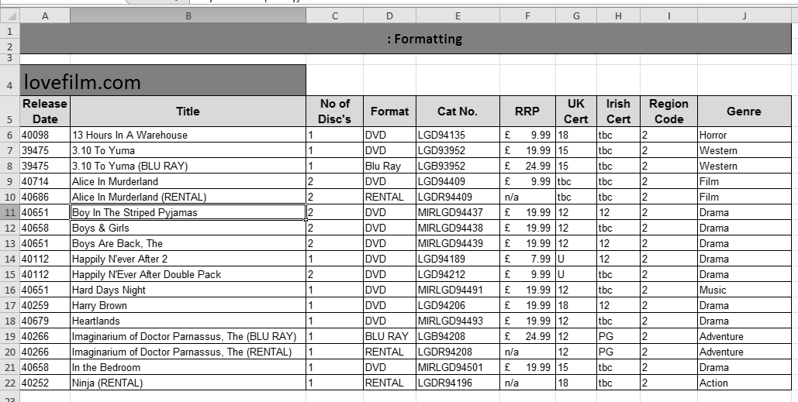
Formatting
Adjusting Column and Rows
Text formatting including alignment and wrapping.
Merging Cells
Borders and Shading
Currency

Slide 5
Number Formatting
Tip: Formatting
You can format a number in numerous ways including using the methods shown on the left.
Tip: Currency
Sometimes a 0 will be displayed as a dash when the numbers have been formatted as a Currency using the method shown on the left.
You need to ensure the formatting of the cell is set to Currency and not Accounting.

Slide 6
Hide and Show Columns/Rows:
To hide/show Rows or Columns to you need to right click on either the column letter or row number. You then need to select hide/show.
If you have hidden the C Column then you would have to select the B & D columns to unhide the C column.
Insert and Delete Columns/Rows:
First select either the column letter or row
Right click your mouse >> select insert
This will insert a row before the selected column or row.
If you would like to delete a row or column you simply highlight the row number or column letter >> right click >> Select Delete.

Slide 7
Merging Cells:
Tip: Merging Cells
Highlight the cells you want to merge
Click on the Merge & Center Icon
Shading and Patterns:
Tip: Shading Cells
You may be asked to put a specific pattern into a cell. You can do this by right clicking your mouse and selecting the Fill Option. You can then select the pattern and colour

Slide 8
Headers & Footers
Header & Footer
Click on Insert for header and footer.
Footer
You can switch from header and footer. You can also add file names, paths etc.
Back to Normal View
You can go back to the normal view if you select any cell and then click on Normal.

Slide 9
Creating Graphs
Highlight the cells that will be required to create the chart.
Select the correct chart (Bar, Pie, line etc.)
You add labels to your axis by using the select data option.
A graph is used to visual display data which is easy to read and interpret.

Slide 10
Formulas
Formulas can be typed into the formula to bar to work out simple calculations.
A formula will begin with a = (equal sign).
Refer to the cell reference (A4) before you write your formula .
You can either type the cell reference or click on the cell.
You can create simple formulas to:
ADD (+)
Multiply (*)
Subtract (-)
Divide (/)
Even if you update the numbers in the cell the formula will automatically work out the new value.

Slide 11
Formulas to replicate values
Values can be replicated from another cell by typing = and then the cell reference.
For example =B4 will copy Barbados in cell I4

Slide 12
Simple Functions
Cell Range for Total, Max &Min (Jan Sales).
Cell Range for Total & Average (Monthly Sales).
The =Sum Function will calculate the total (Sum) of the numbers in the range.
The =Average Function
will calculate the average of the numbers within the range.
The =Max Function will find the highest number in the range.
The =Min Function will find the lowest number in the range.
Functions are predefined formulas and are already available in Excel.

Slide 13
Absolute Reference & Relative Reference
When you use AutoFill to duplicate a formula into the cells below then you must use absolute cell referencing if you want the cells to be referencing to one particular cell.
Absolute cell referencing will lock in a particular cell. To absolute cell reference you must insert a dollar sign before Letter and number of the cell.
All the prices will be multiplied by the % in E3.
The Price is relative referencing. When the formula is dragged down the formula references to the next price.
In the example to the left if you do not use absolute cell referencing on the 25% then the Price will be multiplied against the content in E4.
http://www.yahmad.co.uk/

Slide 14
=Count and CountA
=Count(Range)
This function will count the cells within the range that contain only numbers.
=CountA(Range)
This function will count all the cells within the range that are not empty.
The count function will only Count the cells.
Do not get confused with Sum.
http://www.yahmad.co.uk/

Slide 15
Count IF
=Countif(Range,Criteria)
This function will count the cells which contains a specific criteria from the range
Example: We need to count the Prada bags from the range.
Some times you may have to count all cells apart from a certain criteria.
In this example you we want to count all the brands apart from Marc Jacobs
=countif(Range, “<>Marc Jacobs”)
=Countif(Range,”Prada”) or =Countif(Range,”I19”)
Not: =Countif(Range,“<>criteria”)
http://www.yahmad.co.uk/

Slide 16
Count Functions with Criteria's
Some times you may have to use the following to find a specific criteria:
< - less than
> - more than
= - equal to
=countif(range,”>=2012”)
http://www.yahmad.co.uk/

Slide 17
Count Functions
=Count(Range) - This will count a range of cells which only includes numbers.
=CountA(Range) - This will count all the cells which are not empty.
=Countif(Range,Criteria) - This will count a range of cells which includes a specific criteria.
Not =Countif(Range,”<>Criteria”) – This will count everything apart from the specific criteria.
=CountA
=CountIF(Range,Criteria)
When you reference to a criteria you can either write the criteria in speech marks or reference to a cell that contains the criteria.
Not Count
http://www.yahmad.co.uk/

Slide 18
Count Function Exam Examples

Slide 19
Sum IF
Range: The criteria is “virgin”.
Look at the table and highlight the range of cells which includes “Virgin”.
Criteria: You can either reference to a cell or write the criteria in quotation marks.
SumRange: This will sum up only the criteria values from the sum range.
Criteria
=SUMIF(B4:B10,"virgin",F4:F10)
Range
Sum_Range
A sumif will only sum (add) up from a specific criteria (condition) from the sum_range.
http://www.yahmad.co.uk/

Slide 20
Sum IF with Absolute and Relative Cell Referencing
The Range and the Sum Range have absolute cell referencing.
When the formula is replicated the absolute cell referenced cells will stay the same and will not move position.
H5 is relative cell referencing. It will move down when the formula is replicated.

Slide 21
Average IF
Criteria
Range
Average Range
A averageif will work out the average from a specific criteria (condition) from the average_range.

Slide 22
SumIF Function Exam Examples

Slide 23
IF Statement
If the units sold is more than or equal to the targets sales than the target has been met.
1. Logical Test
Is units sold more than or equal to the target sales.
2. If the statement is true then the “true statement” will be printed in the cell.
3. If the statement is false then the “false statement” will be printed in the cell.
=IF(C5>=D5,"on target","off target")
1. Logical
Test
2. True
3. False
http://www.yahmad.co.uk/

Slide 24
IF Statement with a Calculation
If student discount has been given (“Yes”) then for the true statement you have to calculate 10% of Price. This will be the value for the student discount. If the student discount does not contain “Yes” than the false value (0) will be shown.
1. Logical Test
Does the Cell in D4 equal “Yes”
2. If the Logical Test is true then the calculation (10% of the price) will be shown.
3. If the statement is false then the false value (0) will be shown.
=IF(D4="Yes",C4*10%,0)
1. Logical
Test
2. True
3. False
http://www.yahmad.co.uk/

Slide 25
Nested IF
A nested if will contain more than one true statement. In this example the delivery type will be either A, B or Free.
The Nested if will check the first logical Test. If the first test is false then it will check the next logical test. If both tests are false then the false value will be shown.
1. Logical Test 1
Does the Cell in C4 equal “A”
2. If the Logical Test 1 is true then 3.50 will be printed.
3. Logical Test 2
Does the Cell in C4 equal “B”
2. If the Logical Test 2 is true then 4.50 will be printed.
If both logical tests are false the false value (0) will be printed.
If value is still false then print the false statement
If value is false run the next if statement
=IF(C4="a" ,3.50,IF( C4="b" ,4.50,0))
1. Logical
Test
2. True
1. Logical
Test
2. True
3. False
http://www.yahmad.co.uk/

Slide 26
Exam Question Example: Nested IF
True
True
False
Step 1: Identify the cells which cells will be used for the formula. Cells are shaded in Yellow for now. (B12, B15, B16, B17 & F26)
Step 2: Identify the cell which will be used for the logical Test (B12).
Step 3: Identify the Logical Tests and True Conditions.
Step 4: Identify the False Condition.
B12: Logical Test
(Number of Units)

Slide 27
Exam Question Example: Nested IF (Working out the True and False Conditions)
True
True
False
Lowest
Highest
If(B12<5,
5
If(B12<20,
20
B12: Logical Test
(Number of Units)
Discount A
B15,
Discount B
B16,
Discount C
B17))
* F26
Remember to close the Brackets. Always close with a black bracket.
F26:
Sub Total

Slide 28
If Statement Exam Example
Nested IF Exam Examples
=if(Hours Worked > Contract Hours, “Yes”,
If(Hours Worked = Contract Hours, “No”, “Incomplete”))

Slide 29
Nested IF Exam Examples

Slide 30
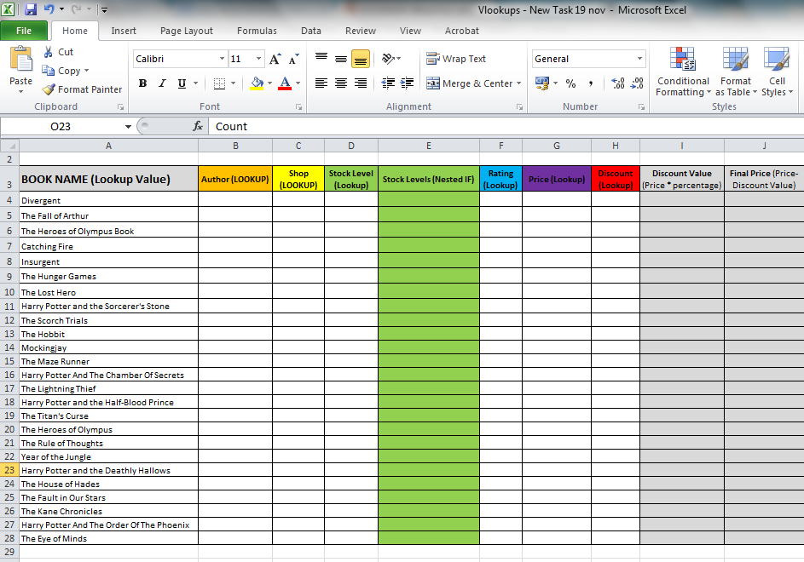
Vlookup
Using VLOOKUP is similar to looking up a person’s name in a telephone book to get a telephone number. VLOOKUP looks at a value in one column, and finds its corresponding value on the same row in another column.
Table_Array or lookup table
We need to use a lookup function to find the corresponding data from the lookup table for each book title .

Slide 31
Vlookup
1. Lookup_Value
2. Table_Array
1) Select the lookup value. The lookup value will appear also in the lookup table (table_array).
2) Select the lookup table (table_array). This may be in the same sheet, next tab or another excel file. Select the lookup value and then the output value. Make sure you absolute cell reference the table_arrray.
Lookup_Value
Output value
Tip: If the table array is on an external sheet then it will automatically Absolute Cell Reference the table.

Slide 32
Vlookup
3. col_Index_num
3) Select the column in the table for the output value. In this example the shop is in the third column of the selected table so therefore you would write 3.
Lookup Value
Column - 3
4) You need to select false which is an exact match. This means the Vlookup will only find an exact match for the output value. Remember to close the brackets.
4. Range_Lookup

Slide 33
Look up a Output Value from a Table Arrray
Tip: When you are looking at the table array you must start from the cell you are looking up. In this Example:
Lookup Value – Player Name (C5)
Lookup Output – Goals Scored (E5)
The output value will always be right of the lookup value.
Lookup Value
Lookup Output

Slide 34
Approximate Lookup
Lookup Value
Lookup Value
Table Array
Table Array
When the lookup value does not have an exact match in the table array then you have to use an approximate match. With the grades example if the percentage (%) is 90 or more than the grade will be A*.

Slide 35
HLOOKUP works horizontally. You will be required to select the row rather than a column for a VLOOKUP.
1) Select the lookup value.
2) Select the Table Array and absolute cell reference if required.
1
2
3) Select the Row to find the output data. In this case the data is in Row 2.
1
2
4) You need to select Approximate or exact match.

Slide 36
LOOKUP
1. Lookup Value
3. [Result_Vector]
2. Lookup_Vector
Looks up a value either from a one-row or one-column range or from an array.
Provided for backward Compatibility

Slide 37
LOOKUP
3. [Result_Vector]
1. Lookup Value
2. Lookup_Vector
The Lookup_Vector and the Result Vector needs to be the same length (number of cells).

Slide 38
Using Extract with LOOKUP Functions
In this example the first character of the Barcode needs to be used a single lookup value in the Table array shown below the table. The match will be an exact Match.
Lookup Value
Cell Reference for lookup
Number of Characters looking up from left
Extract Functions:
Left: Returns the specified number of characters from the start of a text string.
Right: Returns the specified number of characters from the end of a text string.
Mid: Returns the character from the middle of a text string, given a starting position and length.
Table Array

Slide 39
Lookup Exam Examples

Slide 40
Lookup Exam Examples

Slide 41
Nested Functions
Logical Test
True
False
Logical Test
True
False

Slide 42
Sorting Data
Custom sort dialog box which enables sorting by multiple columns or rows.
2) Click on Sort & Filter
>> Custom Sort
1) Select the Table
3) Select sort criteria

Slide 43
Test the Data Model (Test Table)
Use a nested if statement to work out the Bonus Type (A,B,C) & Final Bonus
Add Basic Bonus to (Goals* Bonus Type):
If goals scored is less than is less than 16 than goal bonus is type A.
More than or equal to 16 and less than 30 than goal bonus is type B.
More than or equal to 30 than goal bonus is type C.
Input |  |  | Output
Cell reference | Data chosen | Test Data Type | Cell reference | Expected | Actual
B11 | 1 | Extreme | C11 | Bonus A | Bonus A
B12 | 25 | Normal | C12 | Bonus B | Bonus B

Slide 44
Test the Data Model (2015 Nov Example)
Tip: You should always expect to see the actual outcome before you complete the formula.

Slide 45
Test the Data Model

Slide 46
Conditional Formatting
Highlights (Colour scales) cells based on criteria.
1) Highlight the cell range in which you wish to apply Conditional Formatting.
2) Click On Home >> Conditional Formatting.
3) Click on Highlight Cell Rules
4) Select the Criteria type (Less Than, Between, Equal To, Contains etc)
5) Enter the criteria.
Criteria
Colour
A*C – Green
D – Amber
Less than D - Red

Slide 47
Validation
Data Validation prevents invalid data from being entered into a cell.
For example, you could reject invalid dates or numbers greater than a given value.
You can also force input to be chosen from a dropdown list of values you specify.
1: Click on Data >> Data Validation
List Source
3. You may enter an error message.
This example we have to refer to a list to lookup specific values which can be entered into the cell (/,L or A)
2: Select the list and then the source

Slide 48
Validation
3. You may enter an error message.
1: Click on Data >> Data Validation
This example we have to only allow marks to be entered from 0 to 27 for the Word Processing Exam. If a mark outside of the range is entered than an error message will be shown.
2: Select the Whole Number and then enter the Min and Max numbers in the range.

Slide 49
Rounding
=ROUND | Rounds a number to a specified number of digits.
=ROUNDDOWN | Rounds a number down, towards zero
=ROUNDUP | Rounds a number up, away from zero
=INT | Rounds the number down to the nearest integer

Slide 50
Filtering
Tip: Filtering is used to interrogate the data very similar to how a query works in Access. Highlight the cells you want to filter and then select the filter icon from the tool bar.
Data can be sorted
Tip: You can also do additional filters:
Equals ---- =
Greater Than --- >
Greater Than 0r Equal To --- >=
Less Than ---- <
Between ---- Data And Data
Tip:
You can tick the data you would like to show.

Slide 51
Filtering

Slide 52
Show Formulas
Tip: Make you can see the full formula – you may have to adjust the column widths before you print.
To show formulas click on the formula tab and click on show formulas.
To Return to normal view you have to click the Show Formulas Icon.
You will definitely be asked to print your formulas.

Slide 53
Printing & Saving
Tip: Make sure you select the appropriate print settings.
Tip:
If you are asked to show row or column headings then select this option.
1) Click on Custom scaling options >> Sheet
Tip: Make sure all the columns fit to one page if requested.

Slide 54
Formulas
Values
Values
Values

