Slide 1
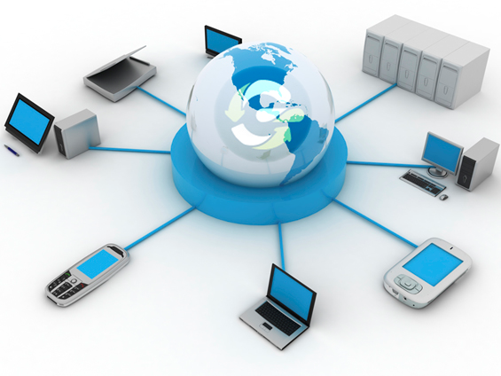
Paper 1 - Theory (Chapter 4 2014)
Exam Questions and Answers

Slide 2
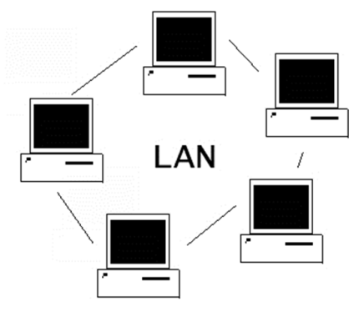
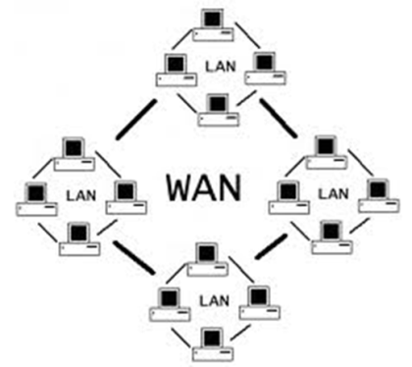
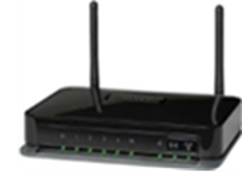
Paper 1 - Theory
11/O/N/14
Describe what is meant by a LAN
LAN is a Local Area Network
LAN covers a small area/one building
A school network is a LAN
Describe what is meant by a WAN
WAN is a wide area network
WAN covers a large geographical area/worldwide
The Internet is a WAN
A WAN consists of connected LANs
Name an item of hardware that would be used to connect a LAN to a WAN.
Router/modem/cable

Slide 3
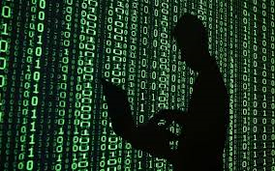
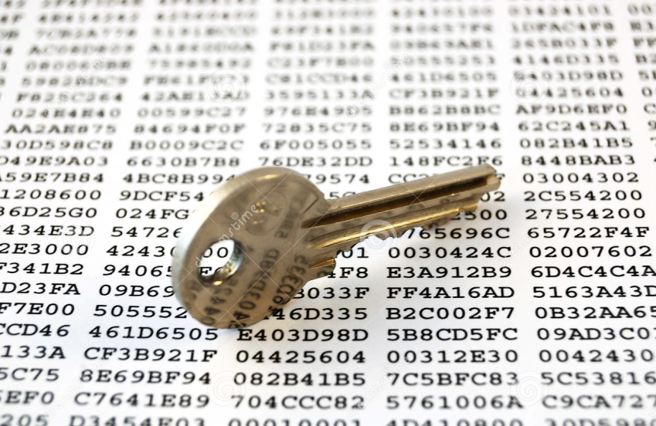
Paper 1 - Theory
11/O/N/14
To prevent the customers’ bank details being read by hackers, the bank uses encryption.
Explain what is meant by encryption.
Causes data to be scrambled/encoded
Requires an encryption key/software to encrypt
Requires a decryption key/encryption/key/software to decrypt
Results in data which is not understandable/readable
Protects sensitive data… from being understood if it falls in to the wrong hands

Slide 4
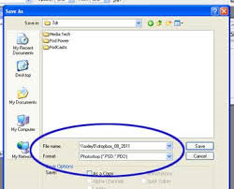
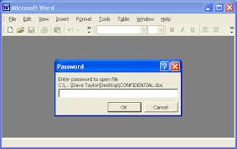
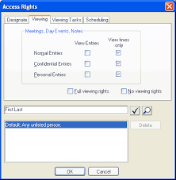
Paper 1 - Theory
12/O/N/14
A number of schools have Local Area Networks (LANs) in their buildings. The LANs are used to share software and for students to save their work.
Describe two ways that students can prevent the work they save from being edited by others.
Make their file/work read only
Password encrypt their file/work
Grant people access to their file/work without permission to edit
Make their file/work hidden
The schools want to connect their LANs to the Internet. Name the device they will need.
Modem/router
As a result of all the schools having access to the Internet, students will be able to communicate with students at other schools in a number of ways. Give two examples of these ways:
Email, Instant messaging, VOIP, Video conferencing

Slide 5
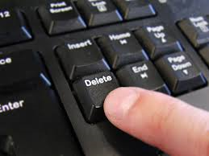
Paper 1 - Theory
12/O/N/14
The head teachers of the schools will want to send confidential data to each other.
Give one advantage and one disadvantage of encryption
Advantage:
Unauthorised users won’t be able to understand data/only person/computer with key can understand data
Disadvantage:
The data can still be deleted/if the person encrypting the data accidentally deletes the encryption key the data will be unreadable
If hackers get into the system, they may plant spyware. Describe what is meant by spyware.
Software that gathers data from computers without the user realising
It monitors and records all key presses
It sends this information back to the hacker who sent it out
Used to gain personal details of users

Slide 6
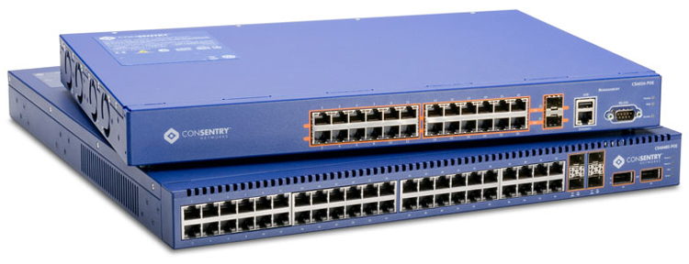
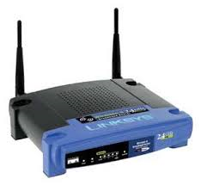
Paper 1 - Theory
11/O/J/14
Most school computer networks have a router and switches.
(a) Explain what is meant by a switch
Switched hub
Has many computers connected to it
Can learn/store addresses of each computer in that part of the network
Can direct data to specific computers/devices
(b) Describe the purpose of a router.
Connects network/computers to the internet
Uses IP addresses
Transfers data between networks
Connects LANs/networks together

Slide 7
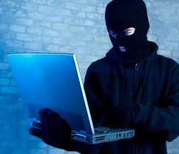
Paper 1 - Theory
11/O/J/14
Banks keep their customer account records on their file servers. Describe three ways in which hackers could misuse this data.
Hackers may read the data and pass it on/find out embarrassing details and pass it on
Hackers may delete the data/remove accounts
Hackers may amend the data/change how much money they have in their account
Hackers may create new accounts to defraud the bank
Transfer money from customer’s accounts to hacker’s own account
Describe the purpose of three different authentication techniques.
Usernames identify the customer to the system/Passwords – customers can’t access the system if they don’t know the password/unauthorised users will not know the password/memorable data
Biometric methods are used because they are unique to each customer so only customer with specific biometric features can access that account
TAN – only customers with the phone that the TAN has been sent to and know the password can access the account
Two factor authentication – only people with device, card and PIN can access the account
Magnetic stripe/smart card/Dongle/card with chip – prevents people without cards/readers/dongle accessing system

Slide 8
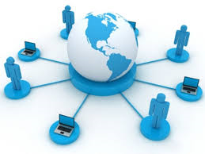
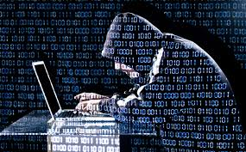
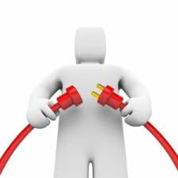
Paper 1 - Theory
11/O/J/14
A school wants to buy some new computers. Some of the computers they buy will be networked and others will be standalone computers which will not be networked.
Describe two advantages of using networked computers.
Fewer printers are needed
Fewer scanners are needed
Can access work from any computer
Data can be shared between computers/data can be accessed by one computer from another more easily
Software can be shared/updated more easily
All computers can access the internet /through one connection
Describe three disadvantages of using networked computers.
Greater risk of hackers
Greater risk of viruses
The significant cost of extra equipment
When the network is down, cannot use network computers/can still use standalones
Print queues can be long

Slide 9
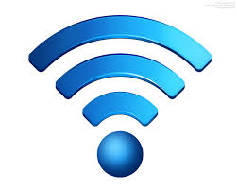
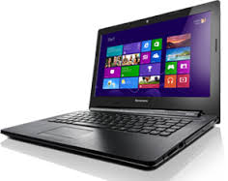
Paper 1 - Theory
11/O/J/14
Eventually the school will use sets of networked Wifi laptops and cabled desktop computers which will also be networked.
Discuss the advantages and disadvantages of using these laptop computers compared with using cabled desktop computers.
Advantages
Laptops can be transported from room to room more easily
Safer – won’t trip over loose cables
Can use laptops outside the classroom if required
Can be used even if there’s a power cut
Disadvantages
Laptops may be more expensive than network PCs.
Display is smaller
Laptops will need recharging periodically
Have to be in range of a network point
One mark available for reasoned conclusion
Must have at least one advantage and disadvantage to gain full marks

Slide 10
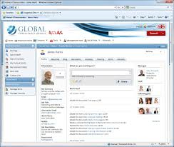
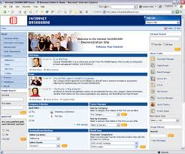
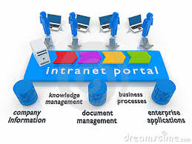
Paper 1 - Theory
12/M/J/13
A small business wishes to set up a Local Area Network (LAN). The manager is not sure whether to use cables to connect the computers or use wireless technology.
Give three disadvantages of using wireless technology.
Limited area of network
Strength of signal is weaker
Easier to hack into/less secure
Physical obstacles can interfere with signal/can cause disconnection
Describe four differences between an intranet and the Internet
Internet is network of networks (Public)
Internet is global
Intranet is within one organisation (Private)
Intranet is private/Internet is public
Intranets tend to be policed/managed
Intranet has an extra layer of security
Data found in an intranet is likely to be more reliable/relevant than that found on the Internet
Internet has more information than an intranet

Slide 11
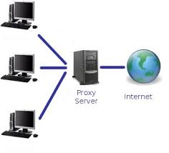
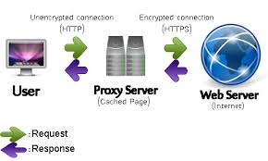
Paper 1 - Theory
13/M/J/13
School networks often contain a router and a proxy server.
Describe the role of a proxy server in such a network.
Can act as a web server
Can act as a buffer (between Internet and LAN)
Server passes on requests to the Internet
Passes the requested web pages to individual computers
Can cache/store the webpages
Subsequent requests for that/those web page(s) are responded to more quickly
Can be used to monitor Internet usage
Can block certain sites
Explain the purpose of a router
Connects a LAN to a WAN
Connects a LAN to the Internet
Forward data packets to the individual computers on a network
Hold the addresses of each computer on the network

Slide 12
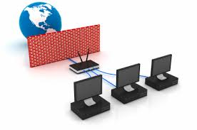
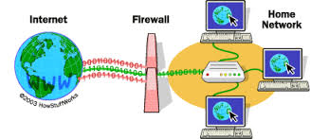
Paper 1 - Theory
11/O/N/12
Explain how a firewall could be used to secure the data in a computer connected to the
internet.
Monitors and controls incoming and outgoing data traffic
Helps to prevent malware getting into computer/from the internet
Prevents computer accessing undesirable/unauthorised sites
Prevents unauthorised computers using the internet accessing the computer
Keeps a list of undesirable sites/IP addresses
Keeps a list of acceptable sites/IP addresses
Warns you regarding threats/allows you to accept/reject downloaded programs

Slide 13
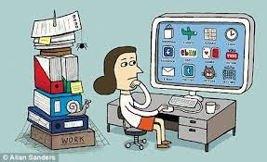
Paper 1 - Theory
11/O/N/12
Aftab owns a company which has a small number of computers. He wants to connect the computers into a network. He does not wish to connect the computers to the internet but he does want the workers to be able to communicate within the company.
(a) Name a network device used to connect the computers together.
Hub/switch/bridge
(b) Name an item of software used to send messages between the computers. Email software/IM software
(c) What is the name given to this type of network?
LAN/intranet
(d) Give three reasons why Aftab may not want his workers to access the internet
They may waste time playing games/going on social network sites/updating their blog/ online
shopping/banking/surfing
They could access undesirable sites
They could download viruses/malware
Could make the company susceptible to hackers

Slide 14
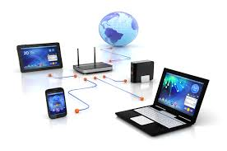
Paper 1 - Theory
13/O/N/12
Aftab owns a company which has a small network of computers.
(a) Give two advantages of having computers networked.
Only one printer is needed
Only one scanner is needed
Data can be shared between computers/data can be accessed by one computer
from another more easily
Software can be shared/updated more easily
All computers can access the internet through one connection
He wants to connect the computers to the internet. (b) Name the device he would need to be able to do this Router/modem
(c) Give two benefits and two drawbacks of connecting to the internet.
Advantages | Disadvantages
Can communicate with other companies by email Can use the internet to place orders Can use the internet to buy materials Can hold video conferences Can create own website to publicise company | Workers may access undesirable sites Workers may waste time playing games/going on social network sites/updating their blog/ online shopping/banking Viruses/malware could be downloaded Could make the company susceptible to hackers

Slide 15
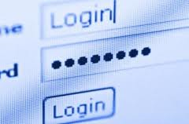
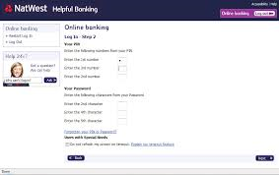
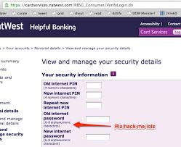
Paper 1 - Theory
13/O/N/12
11 Many banks offer internet banking. To access this online service customers have to log on
to the system.
(a) Explain why authentication techniques are necessary.
Authentication techniques such as user names and passwords identify the user to the system
Without authentication anybody would be able to access data
Hackers would be able to amend/delete data without being prevented
Would have to rely on other methods such as firewalls to prevent unauthorised access.
(b) Customer data is encrypted. Explain what encryption is and why it is used.
Causes data to be scrambled/encoded
Requires an encryption key/software to encrypt
Requires a decryption key/encryption software to decrypt
Results in data which is not understandable/readable
Protects sensitive data… from being understood if it falls in to the wrong hands

Slide 16
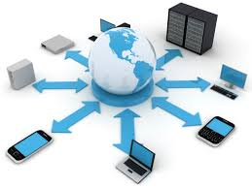
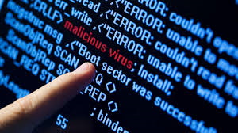
Paper 1 - Theory
13/O/N/11
John and his family have three computers in their home. He wants to connect the computers into a network which will also connect to the internet.
Give two advantages of doing this.
All machines can access internet at the same time
Only one printer is needed
Only one scanner is needed
Data can be shared between computers/data can be accessed by one computer
from another more easily
Software can be shared
All computers can access the internet through one connection
Network games can be played
Give two disadvantages of doing this.
Greater risk of hackers
Greater risk of viruses
Internet usage by children could be more difficult to monitor
The significant cost of extra equipment

Slide 17
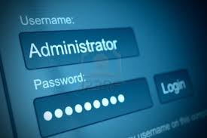
Paper 1 - Theory
13/O/N/11
The use of computer networks can lead to problems of keeping data secure and confidential. Two methods of overcoming this are the use of authentication techniques and data encryption.
Describe two authentication techniques.
User ID and one of password/PIN/memorable data
Password has to be entered before access is gained/password can be changed frequently to avoid hackers guessing them/unsuccessful logins can throw you out of the system
Magnetic stripe/smart card/electronic key/bar code system/ID card/Dongle
Prevents people without cards accessing system
Biometric data
Fingerprint/retina/iris/face/voice recognition used as input/biometric data is difficult to replicate/is unique
Describe data encryption
Key needed to encrypt
Data is jumbled up
Key must be known to decrypt it
Prevents people from understanding data/reading data

Slide 18
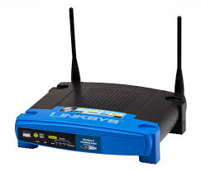
Paper 1 - Theory
12/M/J/10
Aftab and his family have three computers in their home. He wants to connect the computers into a network. Explain why he would need:
A router – so that data can be transferred from one network to another
A browser – to access the (world wide) web /view web pages/surf the net
Email – so that he can send messages to people outside the network/home
An ISP – in order that he can access the internet/email/to provide internet service

Slide 19
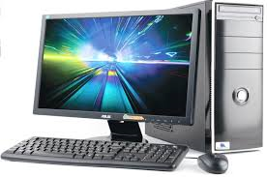
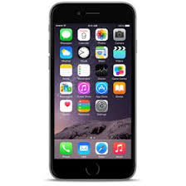
Paper 1 - Theory
11/O/N/13
As well as PCs, mobile phones (cellphones) can be used to access the Internet.
Give two advantages of using a PC rather than a mobile phone for this purpose.
Less likely to lose it
May have stronger signal
Display is larger/keyboard is larger
Content is not as limited
Can be faster to access internet
No problem with batteries running out
Has a mouse so is easier to navigate/use
Give two disadvantages of using a PC rather than a mobile phone for this purpose.
Don’t always have access to PC/there may be a power cut
Difficult to carry/not very portable/mobile phone is portable/Cannot access internet except in the house
You have to buy extra hardware/router

Slide 20
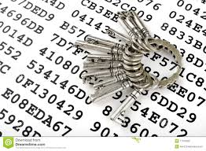
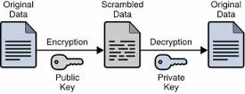
Paper 1 - Theory
11/O/N/13
Describe encryption and discuss the benefits and drawbacks of using it to make data secure.
Causes data to be scrambled/encoded
Requires an encryption key/software to encrypt
Requires a decryption key/encryption software to decrypt
Results in data which is not understandable/readable
Benefits:
Protects sensitive data…
…from being understood if it falls in to the wrong hands
Only user/computer with key can understand data
Drawbacks
Data can still be deleted from system
Criminals can use encryption to keep incriminating material secure

Slide 21
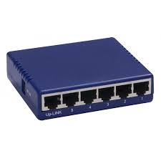
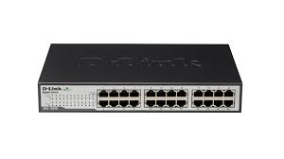
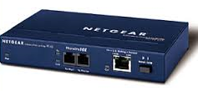
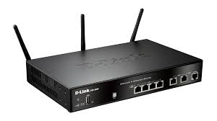
Paper 1 - Theory
11/O/N/10
A large company has two separate sites both of which have a LAN. The manager of the company wants to connect the LANs to form a WAN.
Name three network devices which could be found in a LAN that is not connected to a WAN
Hub
Switch
Bridge
The manager wants to buy a router to connect the LANs. Describe the function of a router.
It stores information about which computer is connected to which network
It receives data packets from an individual computer
It passes the data packets to the appropriate switch
To reduce data collisions
It can connect the LANs to the internet

Slide 22
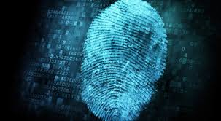
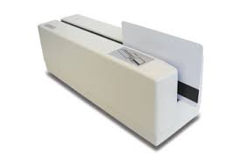
Paper 1 - Theory
11/O/N/10
The company’s workers are concerned that their data may not be secure.
Name three authentication techniques and for each one explain how it will help to prevent illegal access to the data. User name and password
It is very difficult for hackers to guess passwords/if you don’t know password cannot gain
Access to system/data/need to know both username and password to gain access
Biometric data –
Retina scan, fingerprints/handprints, voice recognition etc.
Each of these is unique/very difficult to replicate
Magnetic stripe card
For entry into company premises
Difficult to replicate security information on stripe
PIN
For entry to company premises
It is very difficult for hacker to guess PIN

Slide 23
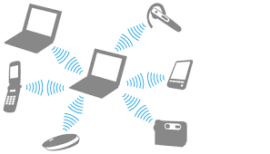
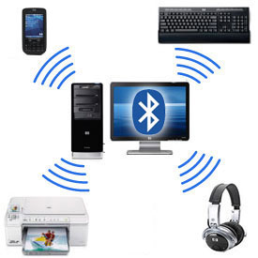
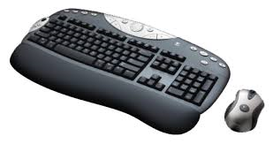
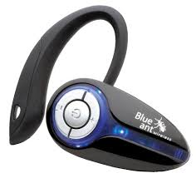
Paper 1 - Theory
11/O/N/10
A small office consists of three rooms each of which has a PC with devices connected to it using cables. The office manager thinks the cables are a safety hazard and wants to remove them.
Name three devices which could be connected to a PC using Bluetooth.
Mouse, Keyboard. Printer, Mobile phone, PDA, Headphones, Webcam, Camera, Microphone, Laptop, Scanner, Graphics tablet, Modem
The manager wants to connect the PCs to form a WLAN. Give two disadvantages of this compared to using cabling
Increased risk of hacking
Limited range of connection
Likelihood of interference
Reduced speed of connection (compared to cabled networks)

Slide 24
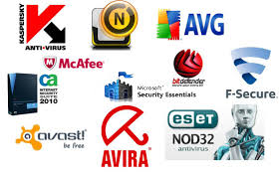
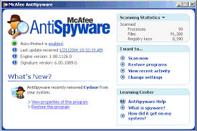
Paper 1 - Theory
11/O/N/10
The company’s workers are concerned that their data may not be secure. Name and describe three methods, other than authentication techniques, which would help to keep the data more secure.
Encryption
Data becomes indecipherable to unauthorised users
Firewall
Prevents unauthorised computers having access to the network
Anti spyware
Removes spyware from computers
Keylogging detection
Enables user to delete software which hacker has planted
Antivirus
Removes viruses from storage media

Slide 25
Paper 1 - Theory
0417/13/O/N/10
A small office has four standalone computers. The office manager wants to connect the computers together to form a LAN.
(a) Name a network device which would have to be present in each computer before they could be networked
Network Card
Give two reasons why a WLAN would be preferable to a cabled LAN.
Reduced cost of cabling
Safer – won’t trip over wires
Easier to connect other devices to the network
Some situations make it impossible to use wired networks
Makes the computer portable as long as it’s within range of the wireless access point/use it
Give two reasons why the manager should not use Bluetooth technology to create the network.
Very slow data transfer speeds
Short distance of coverage/limited signal strength
Greater risk of interception of data/less secure
Supports a limited number of devices in a network

Slide 26
Paper 1 - Theory
0417/13/O/N/10
The company’s workers are concerned that their payroll data may not be secure as a result of the computers being networked. Explain why the workers are concerned.
They are worried that unauthorised users may get into the network
Introduction of viruses/malware … which could result in data being deleted
Spyware could be used to logs key presses to get passwords to access the system
Personal data could be deleted by hackers
Accidental deletion/corruption of data - loss of payroll data would mean workers would not be paid
Data could be amended by hackers - changing payroll data might result in lower wages being paid
Data could be copied by hackers and passed on to other people/workers…
… worker could be embarrassed about other workers knowing their pay
Give three actions that the office manager could take to ensure data security.
Use Biometrics
Have usernames and passwords
Encrypt data
Install a virus checker/anti virus/anti spyware
Introduce firewall(s)
Use an intranet/don’t connect network to internet

