Slide 1
Paper 1 - Theory (Chapter 7.1)
Exam Questions and Answers
Guidance:
0417/11 (2013)
0417/12 (2013)
0417/13 (2013)
0417/11 (201)2
0417/12 (2012)
0417/13 (2012)
0417/11 (2011)
0417/11 (2013)

Slide 2
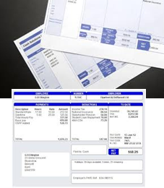
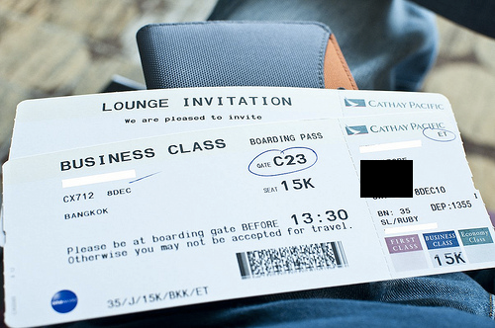
Paper Paper 1 - Theory
Chapter 7.2 - 0417/11 (2013)
10 (a) Describe batch processing of data, using the processing of bank cheques as an example.
Data/cheques are collected together
during the course of the day
Data/cheques are then processed all at once
Data/cheques are processed overnight
Bank accounts updated following morning
No human intervention
(b) Explain why the booking of airline tickets using batch processing would not be a good idea.
It might lead to double booking
Customer would not be sure booking has been successful
Would take a long time to receive confirmation/ticket
Processing would take a long time…
… would cost company money

Slide 3
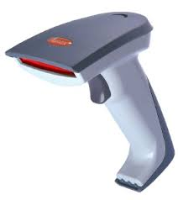
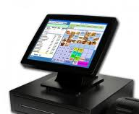
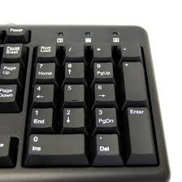
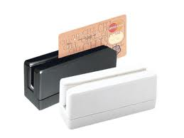
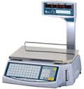
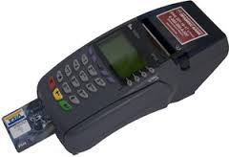
Paper Paper 1 - Theory
Chapter 7.2 - 0417/11 (2013)
8) A customer uses a bank card to purchase a product at a supermarket checkout. The checkout operator uses a number of devices to input data about the customer and the product.
Identify four of these input devices and for each one describe a different item of data that will be input.
Chip reader : Bank/credit card account information/supermarket code
Bar code reader : Information from a product label/product identity number
Electronic scales : Weight of an item
Touch screen: Identification of product
Number pad: Bar code number when bar code reader cannot read bar code/the number of items
Magnetic stripe reader: Information about the customer
Input Devices at POS

Slide 4
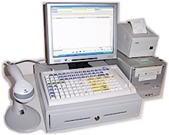
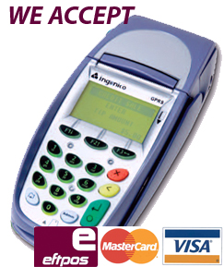
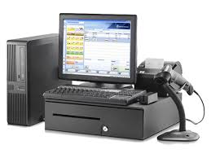
Paper Paper 1 - Theory
Chapter 7.2 - 0417/12 (2013)
18 A supermarket has a number of EFTPOS terminals.
Explain what is meant by EFTPOS and how such a system works. (6)
Electronic Funds Transfer at Point of Sale
Enables payment for goods at a checkout using credit/debit cards
Goods are purchased and bill is calculated
Customer inserts card into chip reader
Card is checked for validity/reported stolen
PIN is entered
PIN is compared with that stored on the chip
If PIN is OK/verified transaction is authorised
If not, customer is asked to re-enter PIN
Supermarket computer contacts customer’s bank
Checks if sufficient funds
If sufficient funds, transaction is completed/if not, transaction is rejected
Amount deducted from customer’s bank account
Amount credited to supermarket’s bank account
The supermarket EFTPOS terminal produces a receipt

Slide 5
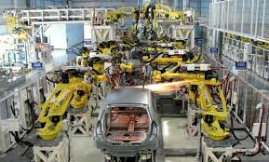
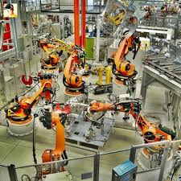
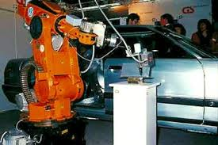
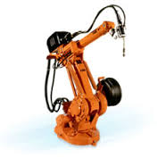
Paper Paper 1 - Theory
Chapter 7.2 - 0417/12 (2013)
9) Robots are now used on many car production lines.
Describe three advantages of this to a car company
Car production is more consistent/robots produce the same standard every time
Cost – once bought they do not have to be paid/fewer employees so lower costs/don’t have to pay robots wages/lower running costs
No industrial disputes
Greater productivity
Greater accuracy/robots are more accurate
Can work in hazardous/extreme conditions/can lift heavier loads
Robots don’t take breaks/can work 24 hours a day 7 days a week/can work continuously

Slide 6
Paper Paper 1 - Theory
Chapter 7.2 - 0417/13 (2013)
18 Robots are now used on many car production lines.
Discuss the benefits and drawbacks to the car company of using robots (7)
Benefits
Car production is more consistent/robots produce the same standard every time
Cost – once bought they do not have to be paid/fewer employees so lower costs/don’t have to pay robots wages/lower running costs
No industrial disputes
Greater productivity
Greater accuracy/robots are more accurate
Can work in hazardous/extreme conditions/can lift heavier loads
Robots don’t take breaks/can work 24 hours a day 7 days a week/can work continuously
Drawbacks
Robots have to be reprogrammed when there is a small change/can’t think for themselves
Robots need programming in order to be adaptable
Expensive start up costs – redundancy payments
Expensive start up costs – have to spend money on training workers to use robots
Expensive start up costs – buying of robots/programming of robots
Computer crash would halt production
Maintenance/repair costs can be expensive

Slide 7
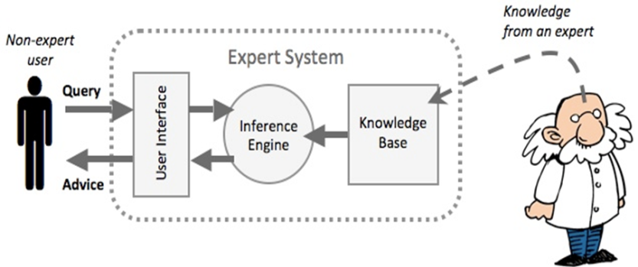
Paper Paper 1 - Theory
Chapter 7.2 - 0417/13 (2013)
11) Car mechanics often use an expert system to help them with their work in diagnosing car engine faults.
Describe how this system would work.
Data is read by sensors/downloaded from onboard computer/entered using keyboard/touch screen/answers to questions are typed in
Uses interactive interface/Asks questions...
........based on previous responses
Expert system analyses data
Inference engine compares data
Compares data with that held in the knowledge base.......
........ using rules base
Matches are found
System suggests possible faults/solutions
1) A user interface - This is the system that allows a non-expert user to query (question) the expert system, and to receive advice.
2) A knowledge base - This is a collection of facts and rules. The knowledge base is created from information provided by human experts
3) An inference engine - This acts rather like a search engine, examining the knowledge base for information that matches the user's query
4) The non-expert user queries the expert system. This is done by asking a question, or by answering questions asked by the expert system.
5) The inference engine uses the query to search the knowledge base and then provides an answer or some advice to the user.

Slide 8
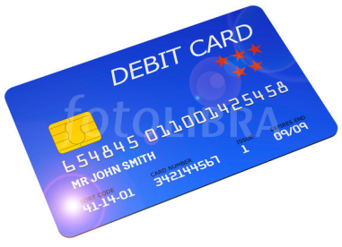
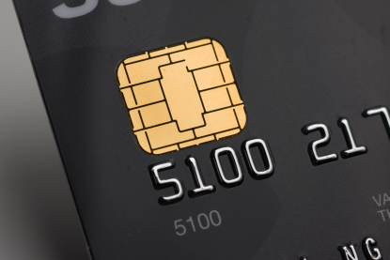
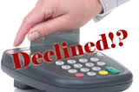
Paper Paper 1 - Theory
Chapter 7.2 - 0417/11 (2012)
13) Computers are used in supermarkets at point of sales terminals. When paying for goods the customer inserts the bank card into the chip reader.
A) Identify three items of data contained in the chip on a bank card.
Card number
PIN
Expiry date
Type of card/issuer
Security number
B) Describe three checks that would be carried out using information on the card before
the bank is asked to authorise the transaction.
Card is valid/card number exists
Card is in date
PIN entered matches that on card
Checks if card is stolen

Slide 9
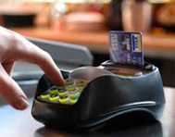
Paper Paper 1 - Theory
Chapter 7.2 - 0417/11 (2012)
13)C Describe five steps which would be carried out by the computers at the supermarket
and at the customer’s bank to complete the transaction.
Customer bank contacted
Bank looks up customer account number
Checks available balance
Checks daily (card) limit
If insufficient funds then transaction is rejected
If sufficient funds then transaction is authorised
Money deducted from customer account
Money credited to supermarket account
8) Tick whether the following statements apply to online processing or batch processing.

Slide 10
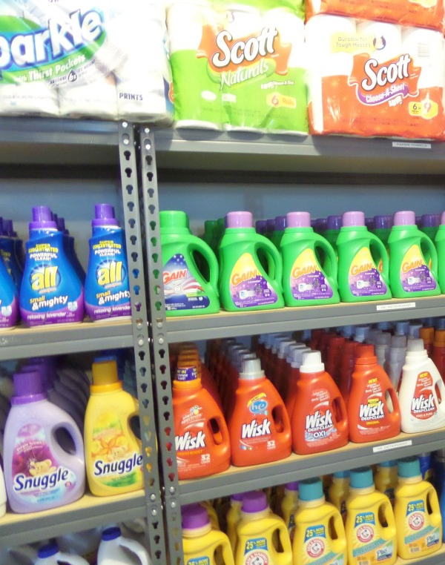
Paper Paper 1 - Theory
Chapter 7.2 - 0417/12 (2012)
13)C The supermarket computer can automatically re-order items when the supermarket is running low on stock.
Describe this process, using the example databases above when two more packets of Kollege Corn Flakes pass through the checkout.
Every time a product is bought, number in stock reduces by 1
Number in stock of Kollege Corn Flakes falls to 150
Compare number in stock with Re-order level
Is equal so needs re-ordering
Kollege Corn Flakes now needs re-ordering
Read off re-order quantity (which is 50)
Read off supplier code L93512
Use suppliers’ database & Lookup supplier code (L93512)
Read off supplier’s name, address - Lu Chen, Kinshasa Highway, Box 41324
Print off re-order request
Print off address label

Slide 11
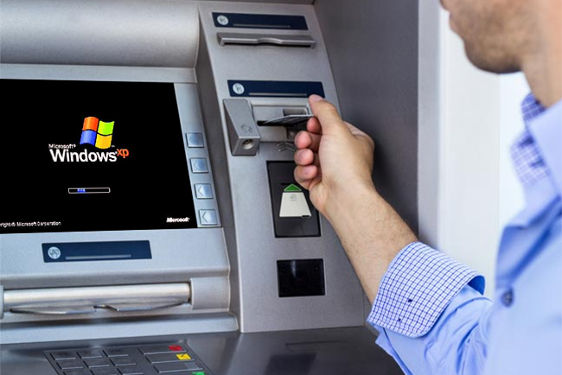
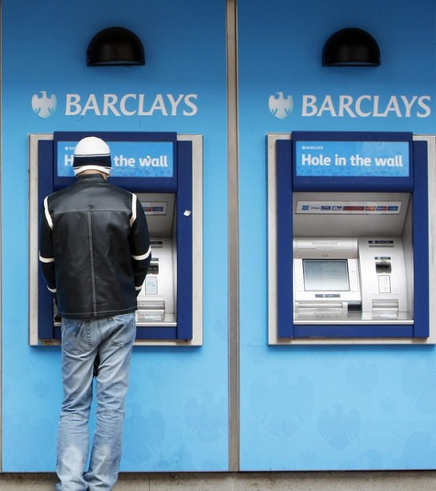
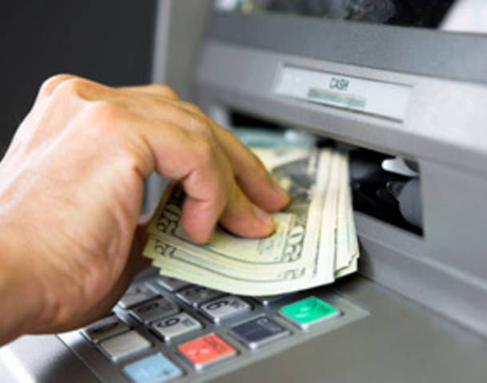
Paper Paper 1 - Theory
Chapter 7.2 - 0417/13 (2012)
15. Give four advantages to bank customers of using ATMs rather than going to the bank to withdraw cash.
No embarrassment of not having sufficient funds
Less time spent queuing
Can get money any time of day or night
Own bank may be further to travel to than nearest ATM
Can use most ATMs/does not have to be own bank
Have choice of languages so is easier to understand/be understood

Slide 12
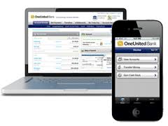
Paper Paper 1 - Theory
Chapter 7.2 - 0417/13 (2012)
14 Sarbjit has a desktop computer at home which he uses for internet banking.
A) Identify two other computer systems he could use to do internet banking when away
from home.
Smart phone
Laptop with internet access
Tablet computer
Discuss the advantages and disadvantages to banks of using internet banking.
Advantages:
Fewer bank tellers so less paid out in wages
Less actual cash handled – fewer robberies
Have access to a wider customer base
Fewer branch offices needed – less spent on rates/rent/utilities
Less money spent on security staff
Disadvantages
Initial cost of hardware/software is expensive
Need to retrain staff
Loss of customers/more difficult to sell other services due to lack of personal touch
Costs of system maintenance

Slide 13
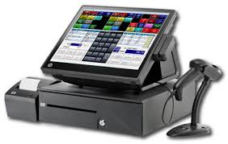
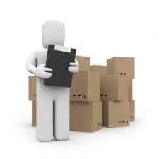
Paper Paper 1 - Theory
Chapter 7.2 - 0417/11 (2011)
12)A supermarket uses POS terminals. The stock levels in the supermarket are updated automatically.
Describe the steps involved in updating the stock level of a product when the bar code is read.
The stock file is searched
Until a match is found with the entered bar code
The number in stock of the matching record is read
One/number purchased is subtracted from the number in stock
The number in stock is compared with the re-order number
If it is equal to/less than the re-order number then more goods are automatically re-ordered
The new value of number in stock is written back to the file
Next bar code is read

Slide 14
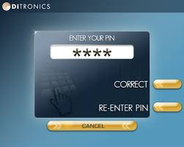
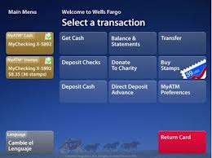
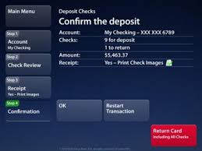
Paper Paper 1 - Theory
Chapter 7.2 - 0417/13 (2011)
17) Chip and pin systems are used at ATMs. A customer wishing to withdraw cash inserts their card. The ATM checks to see if the card is valid and, if so, asks the customer to type their PIN. Describe the computer processing which takes place from this point. (4)
Customer is asked if they want a receipt
The PIN number is compared with that stored in the chip
If they are the same the transaction proceeds
If they are not the same the customer is asked to re-enter PIN
If three attempts transaction rejected and card withheld
The customer is asked which service is required
The customer selects required service (cash)
The customer is asked how much money they want to withdraw
The customer’s account is checked to see if it has sufficient funds
The amount is checked against the card limit
If there are sufficient funds (and the amount is within the card limit) the transaction is authorised/if not transaction is rejected
The amount is deducted from the customer account
The bank notes are issued
The card is returned (by the computer)
If required receipt is printed

