Slide 1
Paper 1 - Theory (Chapter 7 2014)
Exam Questions and Answers
Guidance:
0417/11 Summer
0417/12 Summer
0417/13 Summer
0417/11 (Winter)
0417/12 (Winter)
0417/13 (Winter)

Slide 2
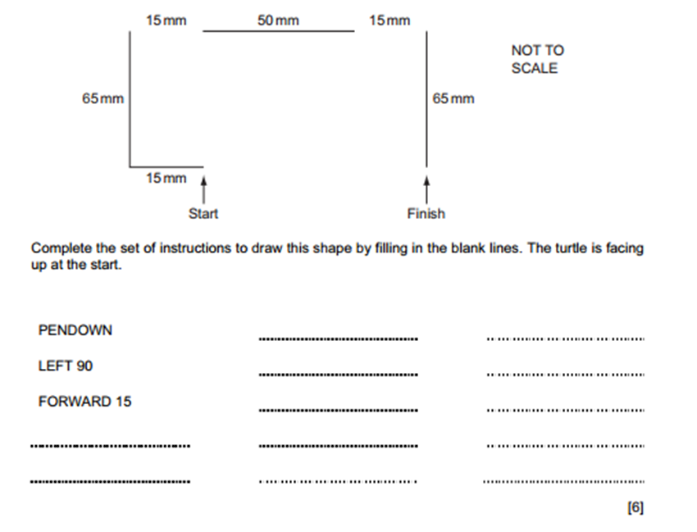
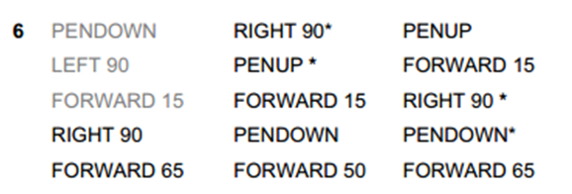
Paper 1 - Theory
0417/11 Summer

Slide 3
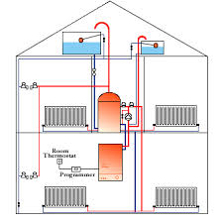
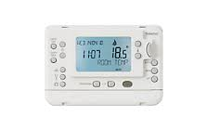
Paper 1 - Theory
0417/11 Summer
Many homes in cold climate areas use microprocessor controlled central heating systems.
Name two input devices used in such a system.
Temperature sensor
Number pad
Remote control
Touch screen
Describe the processing which takes place
Microprocessor stores required temperature as preset value
Microprocessor receives temperature from sensor
Microprocessor compares temperature from sensor to pre-set temperature
If temperature is lower than preset value microprocessor sends a signal to the actuator to turn heater on
If higher than preset value microprocessor sends a signal to turn heater off

Slide 4
Paper 1 - Theory
0417/11 Summer
The Geography teacher in a school has set up an automatic weather station connected to a computer. Name three physical variables which will be measured by sensors.
Humidity, Temperature, Pressure, (Sun)light & Rainfall
Explain why the computer is unable to read the data directly from the sensors.
Sensor measures analogue data
Computer works in digital
Name the device that is needed to enable it to do so.
Analogue to digital converter
Give three advantages to the Geography department of having a computerised weather system rather than a manual weather system.
Computer can take readings during holidays
Computer (readings) are more accurate
Students might forget to take readings/readings can be taken at regular intervals
Readings can be taken more frequently
Readings can be taken any time of day or night
Can produce graphs more quickly/automatically

Slide 5
Paper 1 - Theory
0417/11 Summer
Another group of students are producing a hard copy brochure for the event. These students will need to prepare material to include in this document.
Name two types of software they might use and for each, write down what they would use it for:
Desk Top Publishing Producing the layout/template of the brochure
Database List of characters/actors
Spreadsheet Prices/list of refreshments and costs
Word processing Type/enter/create/produce the text for the brochure/don’t allow write (up) the information
Image editing software/graphics package To prepare images for inclusion in brochure

Slide 6
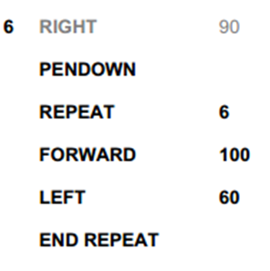
Paper 1 - Theory
0417/12 Summer

Slide 7
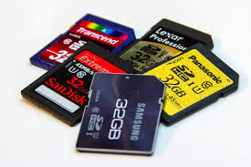
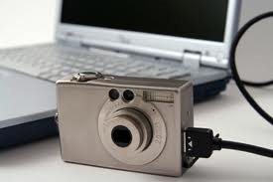
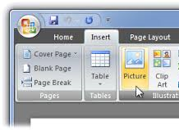
Paper 1 - Theory
0417/12 Summer
A word-processed school newsletter contains only text. The head teacher wants to add images to the newsletter.
Describe how he could include photographs, taken using a digital camera, in the newsletter
Save photos to memory card
Insert memory card to computer
Copy photos to a new folder/desktop/hard disc
Connect camera lead to computer
Import/upload photos
Name two other suitable sources of digital images.
Internet
Create own using a painting/drawing package
CD of images
Clipart library

Slide 8
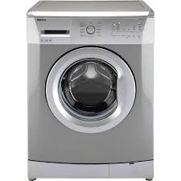
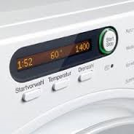
Paper 1 - Theory
0417/12 Summer
Describe the role of the microprocessor in an automatic washing machine
Microprocessor is programmed with pre-set values
Microprocessor starts cycle at specified time
Microprocessor reads data from sensors
Checks contact switch on door is closed
If it isn’t microprocessor will not start the cycle/if it is microprocessor starts cycle
Microprocessor compares sensor readings with pre-set value
If temperature is above pre-set value, microprocessor switches off heater
If temperature is below pre-set value, microprocessor switches on heater
If pressure is greater than preset value, microprocessor sounds alarm
Microprocessor checks pressure reading and calculates the amount of water to use
At start of cycle, microprocessor opens valve to let in water
If water level reached, microprocessor switches off valve
Microprocessor ends cycle at specified time

Slide 9
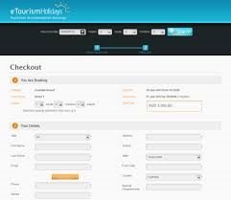
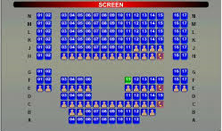
Paper 1 - Theory
0417/12 Summer
A theatre has an on-line booking system. Customers can reserve seats using the Internet with a credit card. The theatre’s computer keeps records of which seats are available.
When the customer pays for a seat the theatre’s computer communicates with the credit card
company’s computer. Describe three checks that the credit card computer will make on the customer’s credit card account
Is credit card number valid/exists
Does name entered match that on system
Is expiry/start date valid/matches date stored on system
Does security code/CVV entered match that stored on system
Is there available credit/funds
Checks for unusual spending patterns
Is card blocked/reported stolen/lost
Describe the processing carried out by the theatre’s computer when the credit card company’s computer authorises the transaction.
Looks up required date of performance
Checks that seats are available
Flags seats as being booked
Stores name of customer with seats booked
Sends email confirmation/text
Prints tickets ready to post or to be collected/sends electronic version of ticket
Deducts number of seats booked from number of seats available/reduces number of seats available (by one)

Slide 10
Paper 1 - Theory
0417/13Summer

Slide 11
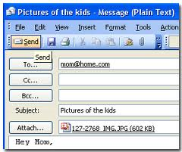
Paper 1 - Theory
0417/13Summer
Describe three advantages and one disadvantage of the library using email rather than a phone call to contact borrowers.
Three advantages from:
Phone call can last a long time
Can send same email to lots of people at same time
Can send advertising literature as an attachment
Borrower may be not available to answer phone
Phone line may be busy
One disadvantage from:
Cannot be sure borrower has received the message
Can be using a computer when other librarians want to use it for other purposes

Slide 12
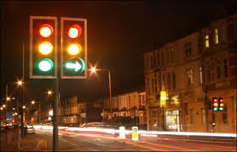
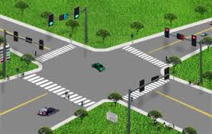
Paper 1 - Theory
0417/13Summer
Computer controlled traffic lights are used at busy road junctions. Light sensors and sound sensors are not used to measure traffic flow.
Giving a different reason for each, explain why these sensors are unsuitable.
Sound – there might be other noises – e.g. roadworks, masking the sound of a car
Light – Anybody could break the beam not just cars/direct sunlight may affect readings
Explain the difference between measurement and control when using microprocessors.
Measurement is the monitoring of physical variables without the microprocessor taking action
Control is when the microprocessor takes action depending on sensor readings

Slide 13
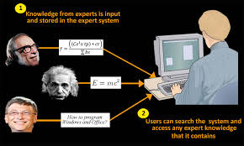
Paper 1 - Theory
0417/13Summer
Doctors use an expert system to help them with their diagnoses of illnesses
The symptoms are typed in by the doctors. Describe the processing which the system uses so that it can suggest possible illnesses.
System/User interface asks questions...
...based on previous responses
Inference engine compares data
Compares data with that held in the knowledge base...
...using rules base
Matches to the symptoms are found
Name two applications other than medical diagnosis and car fault diagnosis which involve the use of expert systems. Two from:
Mineral prospecting
Tax
Careers
Chess games
Animal/plant classification/identification Computer fault diagnosis

Slide 14
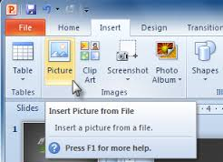
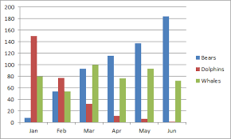
Paper 1 - Theory
0417/13Summer
Students are going to produce a word-processed report about the school greenhouse. It will contain images of the plants that are grown. It will also contain data and charts from a spreadsheet showing the costs of plants.
Describe how the students will produce their report
Save pictures from clipart/Internet/scanned images/digital camera
Load word processing software
Insert images
Edit images
Insert spreadsheet
Position chart/images/spreadsheet
Create chart
Type in text
Edit/format text
Save chart
Insert chart/ copy and paste chart
Edit chart

Slide 15
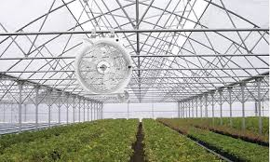
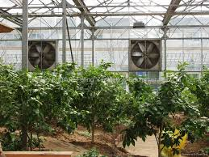
Paper 1 - Theory
0417/11 Winter
A microprocessor in a greenhouse causes fans to come on when the temperature is higher than the preset value and switches them off when it is lower. It also keeps a record of the temperature throughout the day.
Name two types of application software which are being used.
Control
Measuring
Spreadsheet

Slide 16
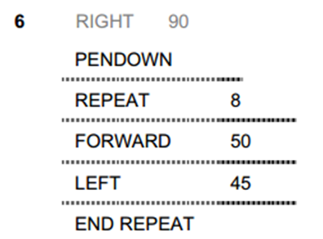
Paper 1 - Theory
0417/11 Winter

Slide 17
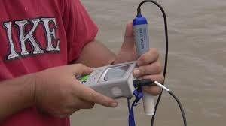
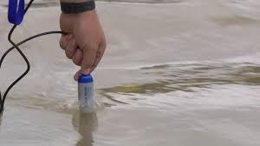
Paper 1 - Theory
0417/11 Winter
Some students are studying the amount of pollution in a river. They are using a computer to
measure the pollution using sensors. The results are recorded and printed.
Name two sensors they should use to measure the amount of pollution.
Temperature sensor, Light sensor, pH sensor, O2 sensor, CO2 sensor
Explain why this is not an example of computer control.
There are no output control devices
The computer is not acting as a result of the input
The output has no effect on the input
Name a type of software which would be used to store the results.
Spreadsheet/database
Name a type of software which would be used to produce a report incorporating graphs. DTP/Word processing/Presentation/web authoring software/database Describe the steps involved in monitoring the pollution.
Sensors are placed in the river
The sensors feedback/sends data to computer
Data is converted from Analogue to Digital/sent through an ADC
Graphs are automatically produced by computer…
Graphs/charts are plotted against time

Slide 18
Paper 1 - Theory
0417/11 Winter
Many teachers are using websites to support their lessons but also use word-processed worksheets.
Describe three features which can be found on a website that would not be present in printed worksheets.
Animation such as cartoons/moving text
Sound such as voiceovers/special sound effects/music
Hyperlinks/hotspot to move between pages/sites
Video such as moving images/reasonable example
Rollovers to change images
Search box to find items on that site quickly

Slide 19
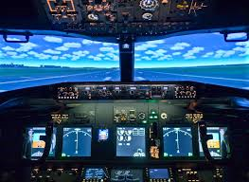
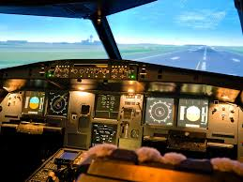
Paper 1 - Theory
0417/11 Winter
Computer simulation is used to train airplane pilots. Give three reasons why a computer simulation is used.
In the event of a crash – safer, no loss of life/injuries
In the event of a crash – don’t have to pay for replacement vehicle/repairs
Can simulate situations which don’t often occur in real life
Can train even in extreme conditions

Slide 20
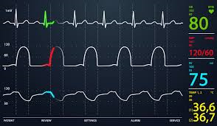
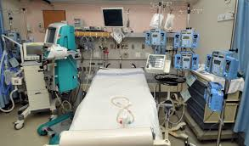
Paper 1 - Theory
0417/11 Winter
A hospital’s intensive care department uses a computer to monitor patients’ conditions.
Give three advantages of using a computer to collect the data rather than having it done by nurses.
Can monitor continuously/readings can be taken more frequently
Nurses can get tired and forget to take readings/nurses are so busy they might not be able to take readings regularly
Computer readings are more accurate/human errors are reduced/Computers are more accurate
More than one variable can be measured at any one time
Results/data can be analysed automatically/Charts are produced automatically
Automatic warnings can be generated/faster to react
Nurses are free to do other tasks
Reduces chances of nurses being exposed to contagious diseases
Reduced cost of wage bill

Slide 21
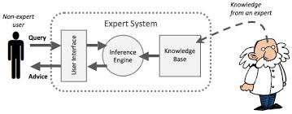
Paper 1 - Theory
0417/11 Winter
A mining company has asked a knowledge engineer to devise an expert system to help them with their prospecting for valuable minerals.
Describe how this expert system would be created.
Data is gathered/collected from experts
Knowledge base is designed/created
A structure to relate each item in the knowledge base is created
An interrogation technique to access the data is created
A user interface/method of displaying the results/method of inputting data/input screen/output
screen is designed/created
The inference engine is designed/created
The rules base is designed/created
The system is tested

Slide 22
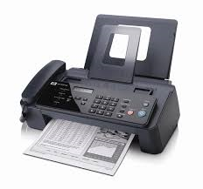
Paper 1 - Theory
0417/11 Winter
When sending documents to each other, companies use email, fax and ordinary post.
Discuss the advantages and disadvantages of each method.
Fax
Personal data more likely to be intercepted by another office worker
Quicker to receive message than using post
Document with signature is legally acceptable via fax
Documents can be lower quality when received
Email
Personal data less likely to be intercepted by another office worker
No need to do printouts therefore more secure/ Has a lower running cost such as paper/ink than fax
Attached documents are better quality in attachment/Email is more environmentally friendly
Multimedia attachments can be sent by email
Quicker to receive message than using post
You can send from anywhere there is an internet connection by email
Easier to send to several recipients at the same time using email
More people have access to email than fax machines
You cannot send solid objects by email
Post
Received more slowly by recipient
Attached documents are better quality in post
Solid objects can be sent by post
You can send from anywhere
Document with signature is legally acceptable
More people have access to post than fax machines

Slide 23
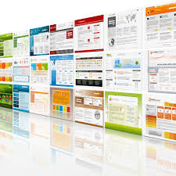
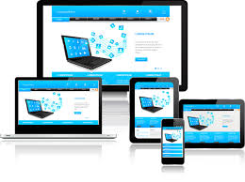
Paper 1 - Theory
0417/11 Winter
Give two advantages and two disadvantages to a company of using a website to advertise, compared with using flyers and posters.
Can reach more people
Easier to update
Can have multimedia which would attract more customers/eye-catching
Two disadvantages from:
More expensive to start up/pay programmers/developers
More expensive to maintain
Need specialist equipment to start with
May not reach target audience

Slide 24
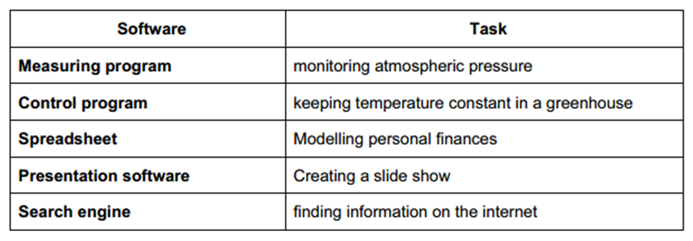
Paper 1 - Theory
0417/12 Winter
Complete the table below by identifying the most appropriate type of software which would be used to carry out each of the following tasks

Slide 25
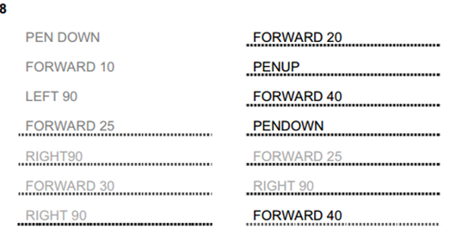
Paper 1 - Theory
0417/12 Winter

Slide 26
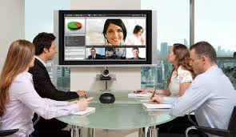
Paper 1 - Theory
0417/12 Winter
A large multi-national company uses video conferencing instead of face to face meetings between branches in different countries.
Apart from a keyboard, mouse and display devices, identify two other devices which must be present in such a system for a video conference to take place.
Router
Web cam
Microphone
Network card
Speakers
Describe four disadvantages of video conferencing.
Takes time/costs money to learn new technology/to be trained
Difficult to have international meetings because of time differences
Initial cost of hardware (and software)
Equipment can break down/power cuts can stop conference
Poor strength of signal/time lag/lip sync can be a problem/connection can be lost
Loss of personal/social contact

Slide 27
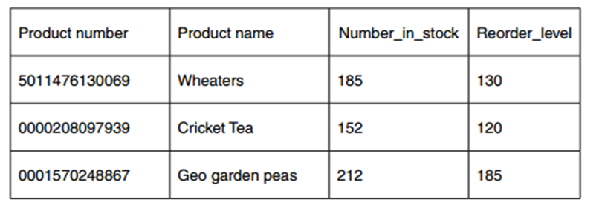
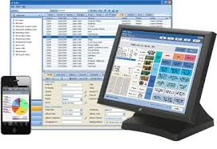
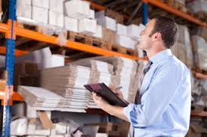
Paper 1 - Theory
0417/12 Winter
A supermarket uses a computerised stock control system.
It has EFTPOS terminals at each of its checkouts. Write down the input devices used to read:
The product numbers of the goods bought by customers: Bar code reader
The customer’s credit card details: Chip/magnetic strip readers
Name the validation check that would be carried out on the product number: Check digit
Describe the computer processing involved in updating the stock file every time a product is sold and checking whether it needs re-ordering.
Product number is searched for in stock file
Matching number in stock reduces by 1
Compare number in stock with re-order level
If number in stock is less than re-order level product is re-ordered
Order is automatically sent to supplier
This is part of the supermarket’s stock file.

Slide 28
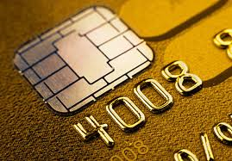
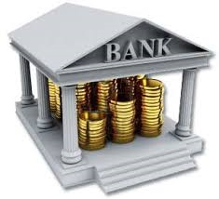
Paper 1 - Theory
0417/12 Winter
The customer has to type in the PIN to authorise the transaction.
Describe the check that is carried out by the EFTPOS terminal
The PIN on the chip is compared with the typed in PIN
After the checks on the customer’s card have been completed, the supermarket computer contacts the customer’s bank. Describe the computer processing involved in taking payment from the customer’s bank.
Bank looks up customer account number
Checks available balance
If insufficient funds then transaction is rejected
If sufficient funds then transaction is authorised
Amount deducted from customer account
Amount credited to supermarket account

Slide 29
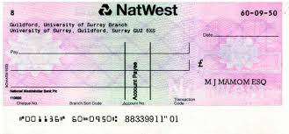
Paper 1 - Theory
0417/12 Winter
Describe what is meant by batch processing, using the processing of bank cheques as an example.
Cheques are collected together…
…during the course of the day
Cheques are then processed all at once
Cheques are processed overnight
Bank accounts updated following morning

Slide 30
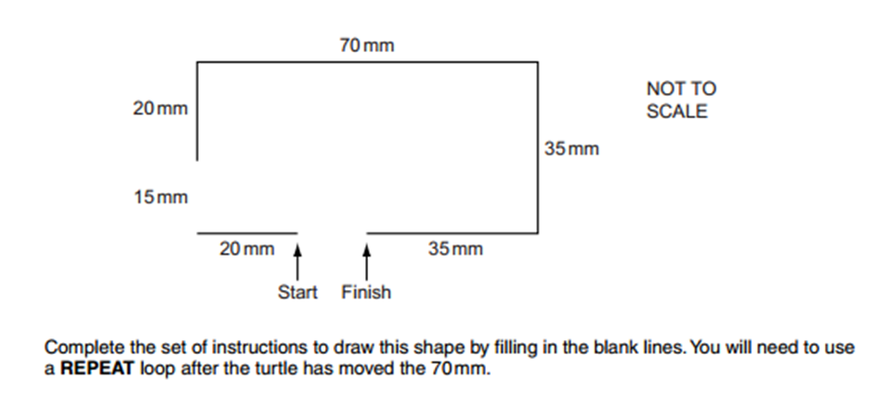
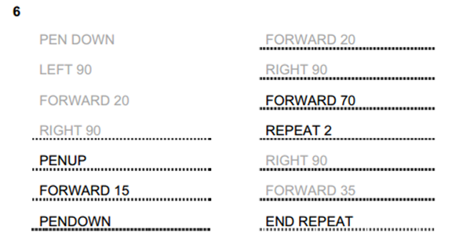
Paper 1 - Theory
0417/13 Winter

Slide 31
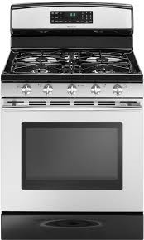
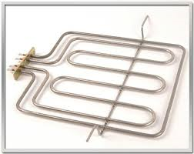
Paper 1 - Theory
0417/13 Winter
A meal is to be cooked using a microprocessor controlled oven.
Identify two variables which have to be pre-set before the cooking begins.
Temperature
Time
Describe the role of the microprocessor in controlling the oven.
Microprocessor switches heater on
Microprocessor receives data from temperature sensor
Temperature of oven is compared with pre-set value by microprocessor
If higher microprocessor switches heater off
If lower microprocessor leaves heater on
Time is constantly monitored by microprocessor
Time elapsed/finish time is compared to pre-set time by microprocessor
If equal then heater is switched off by microprocessor…
…microprocessor causes buzzer to sound

Slide 32
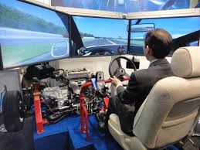
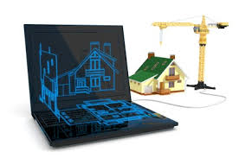
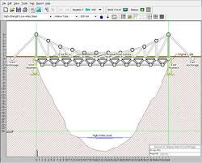
Paper 1 - Theory
0417/13 Winter
Give two reasons, apart from safety, why computer models are often used rather than the real thing.
Cost of building real thing may be expensive
Real thing may waste raw materials/natural resources
Easier to change data/variables
Costs less to change data/variables
The real thing may be impossible to access/create
Real thing may be on too vast a scale
Extremes which can’t be tested in real life can be tested using models

Slide 33
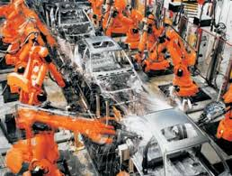
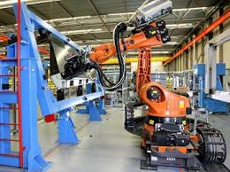
Paper 1 - Theory
0417/13 Winter
A car manufacturer uses robots on its production line.
Describe four disadvantages to the company of using robots to build cars.
Robots have to be reprogrammed when there is a small change/can’t think for themselves
Robots need programming in order to be adaptable
Expensive start-up costs – redundancy payments
Expensive start-up costs – have to spend money on training workers to use robots
Expensive start-up costs – buying of robots/programming of robots
Computer crash would halt production
Maintenance/repair costs can be expensive
Identify two changes to the workers’ working environment that the use of robots has brought about.
It is quieter
They have a safer environment
It is a cleaner environment

